Slide 1



@powertechspeck
SEPTEMBER 30, 2026
Copilot Studio
User Group
Event Host: Girish Uppal & Nehal Shah
Brisbane, Australia

Slide 2


@powertechspeck
Warning
If you do not consent to being part of recording, please exit this event now
Recording available post event at:
Girish’s YouTube Channel https://www.youtube.com/@powertechspeck
Nehal’s YouTube Channel https://www.youtube.com/@ThePowerBrews
Event Recorded

Slide 3



COPILOT STUDIO USER GROUP, BRISBANE AUSTRALIA
GITHUB COPILOT HARNESS
Sandeep Angara
30 SEPTEMBER 2026

Slide 4

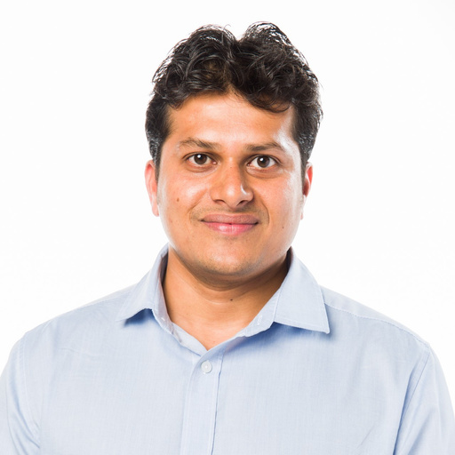
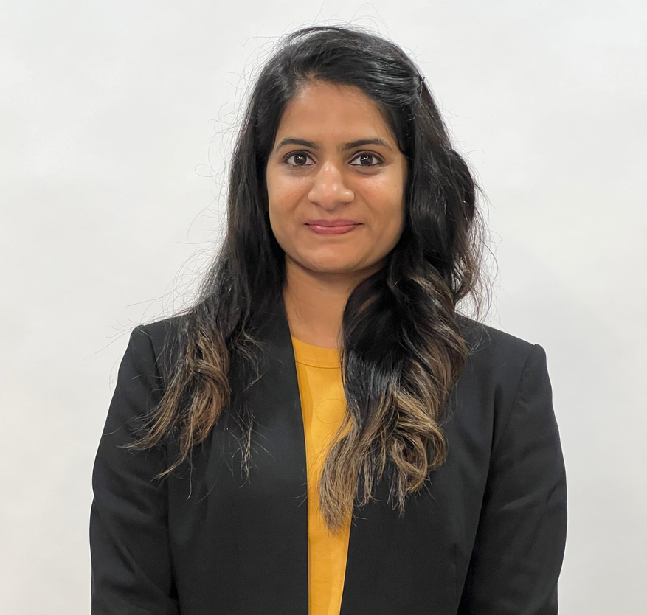
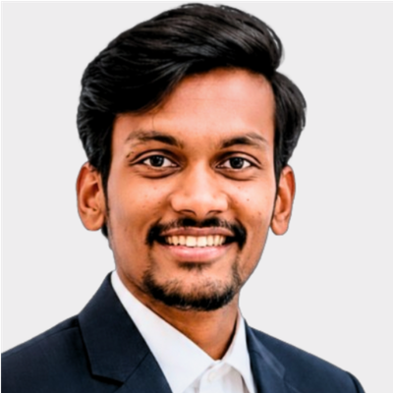
@powertechspeck
Meet Event Host
Meet Speaker
GIRISH UPPAL
NEHAL SHAH
SANDEEP ANGARA
Tech Consultant
Consultant
Microsoft

Slide 5

BRISBANE, AUSTRALIA
COPILOT STUDIO USER GROUP
Together we learn
Much Better
TECH COMMUNITY
https://techcommunity.microsoft.com/group/copilot-studio-user-group-australia
POWER PLATFORM COMMUNITY
https://community.powerplatform.com/usergroups/details/?groupid=5d1ae660-e577-f011-b4cb-6045bdd8118b

